Slide 1
Channel Access Client APIs
Andrew Johnson — Computer Scientist, AES-SSG
Includes material by Kay Kasemir, ORNL

Slide 2
Channel Access
The main programming interface for writing Channel Access clients is the C library that comes with EPICS base
  Internally uses C++, but API is pure C
Almost all CA client interfaces in other languages call the C library
  Main exception: Pure Java library ‘CAJ’ (may still have some issues)
Documentation:
  EPICS R3.14 Channel Access Reference Manual by Jeff Hill et al.
  CA - Perl 5 interface to EPICS Channel Access by Andrew Johnson
  In <base>/html, or from the EPICS web site
This lecture covers
  Fundamental API concepts (using Perl)
  Template examples in C, discussion of Matlab and Java

Slide 3
Why teach the Perl API?
Simpler, easier to learn than C
Same principles, less code required
Perl 5 API calls C interface internally
  Builds on most Unix-like workstation platforms (not Windows)

Slide 4
Search and Connect to a PV
use lib '/path/to/base/lib/perl';
use CA;
my $chan = CA->new($ARGV[0]);
CA->pend_io(1);
printf "PV: %s\n", $chan->name;
printf " State: %s\n", $chan->state;
printf " Host: %s\n", $chan->host_name;
my @access = ('no ', '');
printf " Access rights: %sread, %swrite\n",
$access[$chan->read_access], $access[$chan->write_access];
printf " Data type: %s\n", $chan->field_type;
printf " Element count: %d\n", $chan->element_count;
This is the basic cainfo program in Perl (without error checking)

Slide 5
Get and Put a PV
use lib '/path/to/base/lib/perl';
use CA;
my $chan = CA->new($ARGV[0]);
CA->pend_io(1);
$chan->get;
CA->pend_io(1);
printf "Old Value: %s\n", $chan->value;
$chan->put($ARGV[1]);
CA->pend_io(1);
$chan->get;
CA->pend_io(1);
printf "New Value: %s\n", $chan->value;
This is the basic caput program in Perl (without error checking)

Slide 6
Monitor a PV
use lib '/path/to/base/lib/perl';
use CA;
my $chan = CA->new($ARGV[0]);
CA->pend_io(1);
$chan->create_subscription('v', \&val_callback);
CA->pend_event(0);
sub val_callback {
my ($chan, $status, $data) = @_;
if (!$status) {
printf "PV: %s\n", $chan->name;
printf " Value: %s\n", $data;
}
}
This is a basic camonitor program in Perl (without error checking)

Slide 7
Error Checking
What happens if the PV search fails, e.g. the IOC isn't running, or it's busy and takes longer than 1 second to reply?
  CA->pend_io(1) times out
  CA library throws a Perl exception (die)
  Program exits after printing:
    ECA_TIMEOUT - User specified timeout on IO operation expired at test.pl line 5.
We can trap the Perl exception using
  eval {CA->pend_io(1)};
  if ($@ =~ m/^ECA_TIMEOUT/) { ... }
How can we write code that can recover from failed searches and continue doing useful work?

Slide 8
Event-driven Programming
First seen when setting up the CA monitor:
  $chan->create_subscription('v', \&callback);
  CA->pend_event(0);
  The CA library executes our callback subroutine whenever the server provides a new data value for this channel
  The CA->pend_event() routine must be running for the library to execute callback routines
    The Perl CA library is single threaded
    Multi-threaded C programs can avoid this requirement
Most CA functionality can be event-driven

Slide 9
Event-driven PV Search and Connect
use lib '/path/to/base/lib/perl';
use CA;
my @chans = map {CA->new($_, \&conn_callback)} @ARGV;
CA->pend_event(0);
sub conn_callback {
my ($chan, $up) = @_;
printf "PV: %s\n", $chan->name;
printf " State: %s\n", $chan->state;
printf " Host: %s\n", $chan->host_name;
my @access = ('no ', '');
printf " Access rights: %sread, %swrite\n",
$access[$chan->read_access], $access[$chan->write_access];
printf " Data type: %s\n", $chan->field_type;
printf " Element count: %d\n", $chan->element_count;
}
The cainfo program using callbacks

Slide 10
Event-driven PV Monitor
use lib '/path/to/base/lib/perl';
use CA;
my @chans = map {CA->new($_, \&conn_cb)} @ARGV;
CA->pend_event(0);
sub conn_cb {
my ($ch, $up) = @_;
if ($up && ! $monitor{$ch}) {
$monitor{$ch} = $ch->create_subscription('v', \&val_cb);
}
}
sub val_cb {
my ($ch, $status, $data) = @_;
if (!$status) {
printf "PV: %s\n", $ch->name;
printf " Value: %s\n", $data;
}
}
The camonitor program using callbacks

Slide 11
Data Type Requests
Most data I/O routines handle data type automatically
  $chan->get fetches one element in the channel’s native type
    Value is returned by $chan->value
    Arrays are not supported, no type request possible
  $chan->get_callback(SUB) fetches all elements in the channel’s native data type
    Optional TYPE and COUNT arguments to override
  $chan->create_subscription(MASK, SUB) requests all elements in the channel’s native type
    Optional TYPE and COUNT arguments to override
  $chan->put(VALUE) puts values in the channel’s native type
    VALUE may be a scalar or an array
  $chan->put_callback(SUB, VALUE) puts values in the channel’s native data type
    VALUE may be a scalar or an array

Slide 12
Specifying Data Types
The TYPE argument is a string naming the desired DBR_xxx type
  See the CA Reference Manual for a list
The COUNT argument is the integer number of elements
If you request an array, the callback subroutine’s $data argument becomes an array reference
If you request a composite type, the callback subroutine’s $data argument becomes a hash reference
  The hash elements are different according to the type you request
  See the Perl Library documentation for details

Slide 13
Base caClient template
EPICS Base Includes a makeBaseApp.pl template that builds two basic CA client programs written in C:
  Run this
  makeBaseApp.pl -t caClient cacApp
  make
  Result
  bin/linux-x86/caExample <some PV>
  bin/linux-x86/caMonitor <file with PV list>
  Then read the sources, compare with the reference manual, and edit/extend to suit your needs

Slide 14
CaClient's caExample.c
Minimal CA client program
Fixed timeout, waits until data arrives
Requests everything as ‘DBR_DOUBLE’
  … which results in values of type ‘double’
  See db_access.h header file for all the DBR_… constants and the resulting C types and structures
  In addition to the basic DBR_type requests, it is possible to request packaged attributes like DBR_CTRL_type to get { value, units, limits, …} in one request

Slide 15
Excerpt from db_access.h
/* values returned for each field type
…
* DBR_DOUBLE returns a double precision floating point number
…
* DBR_CTRL_DOUBLE returns a control double structure (dbr_ctrl_double)
*/
…
/* structure for a control double field */
struct dbr_ctrl_double{
dbr_short_t status; /* status of value */
dbr_short_t severity; /* severity of alarm */
dbr_short_t precision; /* number of decimal places */
dbr_short_t RISC_pad0; /* RISC alignment */
char units[MAX_UNITS_SIZE]; /* units of value */
dbr_double_t upper_disp_limit; /* upper limit of graph */
dbr_double_t lower_disp_limit; /* lower limit of graph */
dbr_double_t upper_alarm_limit;
dbr_double_t upper_warning_limit;
dbr_double_t lower_warning_limit;
dbr_double_t lower_alarm_limit;
dbr_double_t upper_ctrl_limit; /* upper control limit */
dbr_double_t lower_ctrl_limit; /* lower control limit */
dbr_double_t value; /* current value */
};

Slide 16
caClient's caMonitor.c
Better CA client program
  Registers callbacks to get notified when connected or disconnected
  Subscribes to value updates instead of waiting
  … but still uses one data type (DBR_STRING) for everything

Slide 17
Ideal CA client?
Register and use callbacks for everything
  Event-driven programming; polling loops or fixed time outs
On connection, check the channel’s native type
  Limit the data type conversion burden on the IOC
Request the matching DBR_CTRL_type once
  this gets the full channel detail (units, limits, …)
Then subscribe to DBR_TIME_type for time+status+value updates
  Now we always stay informed, yet limit the network traffic
  Only subscribe once at first connection; the CA library automatically re-activates subscriptions after a disconnect/reconnect
This is what MEDM, StripTool, etc do
  Quirk: They don't learn about run-time changes of limits, units, etc.
    Recent versions of CA support DBE_PROPERTY monitor event type
    This solves that issue

Slide 18
Side Note: SNL just to get CAC help
This piece of SNL handles all the connection management and data type handling:
  double value;
  assign value to "fred";
  monitor value;
Extend into a basic 'camonitor':
  evflag changed;
  sync value changed;
  ss monitor_pv
  {
  state check
  {
  when (efTestAndClear(changed))
  {
  printf("Value is now %g\n", value);
  } state check
  }
  }

Slide 19
Quick Hacks, Scripts
In many cases, scripts written in bash/perl/python/php can just invoke the command-line ‘caget’ and ‘caput’ programs
Especially useful if you only need to read/write one PV value and not subscribe to value updates
CA Client library bindings are available for Perl, Python & PHP
  Perl bindings are included in EPICS Base (not on MS Windows)
  You have to find, build and update them for Python and PHP
    Your script may be portable, but you still have to install the CAC-for-p* binding separately for Linux, Win32, MacOS…

Slide 20
Quick Perl Example
# caget: Get the current value of a PV
# Argument: PV name
# Result: PV value
sub caget {
my ($pv) = @_;
open(my $F, "-|", "caget -t $pv") or die "Cannot run 'caget'\n";
$result = <$F>;
close $F;
chomp $result;
return $result;
}
# Do stuff with PVs
$fred = caget("fred");
$jane = caget("jane");
$sum = $fred + $jane;
printf("Sum: %g\n", $sum);

Slide 21
Matlab 'MCA' Extension
Same setup & maintenance issue as for p/p/p!
  … but may be worth it, since Matlab adds tremendous number crunching and graphing.
Initial setup
  Get MCA sources (see links on EPICS website)
  Read the README, spend quality time with MEX
Assume that's done by somebody else
  ‘caget’ from EPICS base works
  Matlab works (try "matlab -nojvm -nodesktop")
Do this once:
cd $EPICS_EXTENSIONS/src/mca
source setup.matlab
  … and from now on, Matlab should include MCA support

Slide 22
MCA Notes
Basically, it's a chain of
  pv = mcaopen('some_pv_name');
  value = mcaget(pv);
  mcaput(pv, new_value);
  mcaclose(pv);
Your pv is ‘connected’ from ..open to ..close
  When getting more than one sample, staying connected is much more efficient than repeated calls to ‘caget’
Try ‘mca<tab>’ command-line completion to get a list of all the mca… commands
Run ‘help mcaopen’ etc. to get help

Slide 23
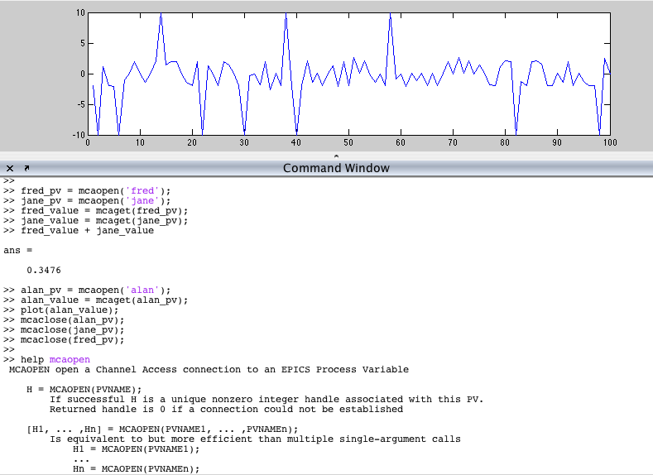
Matlab/MCA Examples

Slide 24
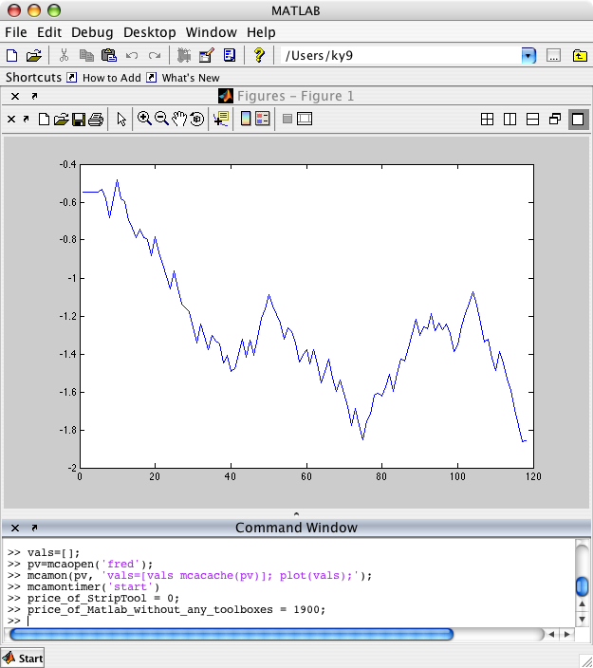
MCA Value Subscription

Slide 25
Java
There are now 2 CA bindings, using JNI or pure Java
  Only difference is the initialization, they support the same API
  Usage very much like C interface, “real programming” as opposed to Matlab, but in the more forgiving Java VM
A Java CA example can be found at
  http://ics-web.sns.ornl.gov/kasemir/train_2006/4_2_Java_CA.tgz

Slide 26
Acknowledgements
Channel Access on every level in detail:
  Jeff Hill (LANL)
makeBaseApp.pl
  Ralph Lange (BESSY) and others
Perl CA bindings
  Andrew Johnson (APS)
MCA
  Andrei Terebilo (SLAC) is the original author,
  Carl Lionberger maintained it for a while (then at SNS)
Java CA
  Eric Boucher is the original author (then at APS)
  Matej Sekoranja maintains it, he added the pure java version (Cosylab)

